Slide 1
Learning intentions and success criteria
I am learning…
I can…
About SQL
SELECT, INSERT INTO, UPDATE, and DELETE Queries
Write SQL queries to search through and modify a database

Slide 2

DDD Revision
N5 – Database Design & Development

Slide 3
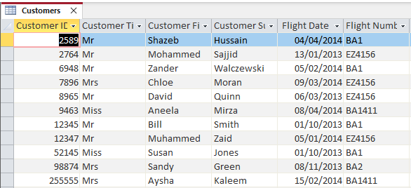
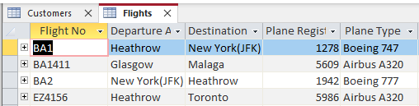
Database Example
Customers Table
Flights Table
3

Slide 4
Structured Query Language
SQL queries are used to search, sort, or manipulate a database. There are 4 types you need to know:
SELECT – View specific data
INSERT INTO – Add records into an entity
UPDATE – Update one or more fields in an entity
DELETE – Remove one or more records from an entity
4

Slide 5
SQL: SELECT
Select statements are used to view data from a database – example:
SELECT *
FROM Flights
WHERE FlightNo = “BA1”
This will display all records which match the search criteria.
5

Slide 6
Search Criteria
The search criteria is like an if-statement – you choose which records display and which ones do not:
SELECT * FROM Flights
WHERE Departure Airport = “Heathrow”
All flights which depart from Heathrow
WHERE Passengers > 100
All flights with over a hundred passengers
WHERE Plane Reg = “1942” OR Plane Reg = “7254”
Flights from either plane 1942 or plane 7254
WHERE Passengers > 20 AND Passengers < 50
Flights with passenger numbers between 20 and 50
6

Slide 7
SQL: SELECT
You can add an ORDER BY line to specify alphabetical/numerical order – either ASCencing or DESCending
SELECT *
FROM Flights
ORDER BY Destination ASC
This will display all records sorted by the Destination field from A to Z.
7

Slide 8
SQL: Insert into
This statement adds a record into an existing entity:
INSERT INTO Flights
VALUES (KLM1, Edinburgh, Madrid, 2654, Boeing 777)
When inserting values, they must be in the same order as the entity.
KLM1
Edinburgh
Madrid
2654
Boeing 777
8

Slide 9
SQL: Update
This statement changes the data in existing records:
UPDATE Flights
SET Destination = “Paris”
WHERE Plane Type = “Airbus A380”
If you do not have a WHERE clause then all records will be updated (e.g. all destinations will be Paris).
Paris
Paris
9

Slide 10
SQL: Delete
This statement removes one or more records based on a criteria:
DELETE FROM Flights
WHERE Departure Airport = “Heathrow”
If you do not have a WHERE clause the whole table will be deleted.
10

Slide 11
SQL Cheat-Sheet
Search for Records
SELECT attribute1, attribute2, …
FROM table_name
WHERE criteria
ORDER BY attribute ASC or DESC
Update a Record
UPDATE table_name
SET attribute = value
WHERE criteria
Add a Record
INSERT INTO table_name
VALUES (value1, value2, …)
Delete a Record
DELETE FROM table_name
WHERE criteria
11

